Slide 1

C# for Java Developers
Part 2: C# Advanced
By Hung Vong Vinh
08.2020

Slide 2
Contents
Introduction to C#
Advanced C#
1. Overview
2. Types
3. Expressions
4. Declarations
5. Statements
6. Classes and Structs
7. Inheritance
8. Interfaces
9. Delegates
10. Exceptions
11. Attributes
12. Threads
13. Generic
14. LINQ
15. Other features
References:
B.Albahari, P.Drayton, B.Merrill: C# Essentials. O'Reilly, 2001
S.Robinson et al: Professional C#, Wrox Press, 2001
Online documentation on the .NET SDK CD
https://en.wikipedia.org/wiki
ELCA VN 2007 v1.0
Notes:
First part: Introduction (2h30)
Second part: Advanced (2h30)
Third part: examples and .NET intro (1h00)

Slide 3
Inheritance
ELCA VN 2007 v1.0

Slide 4
Syntax
class A { // base class
int a;
public A() {...}
public void F() {...}
}
class B : A { // subclass (inherits from A, extends A)
int b;
public B() {...}
public void G() {...}
}
B inherits a and F(), it adds b and G()
- constructors are not inherited
- inherited methods can be overridden (see later)
Single inheritance: a class can only inherit from one base class, but it can implement multiple interfaces.
A class can only inherit from a class, not from a struct.
Structs cannot inherit from another type, but they can implement multiple interfaces.
A class without explicit base class inherits from object.
ELCA VN 2007 v1.0

Slide 5
Asignments and Type Checks
class A {...}
class B : A {...}
class C: B {...}
Assignments
A a = new A(); // static type of a: the type specified in the declaration (here A)
// dynamic type of a: the type of the object in a (here also A)
a = new B(); // dynamic type of a is B
a = new C(); // dynamic type of a is C
B b = a; // forbidden; compilation error
Run time type checks
a = new C();
if (a is C) ... // true, if dynamic type of a is C or a subclass; otherwise false
if (a is B) ... // true
if (a is A) ... // true, but warning because it makes no sense
a = null;
if (a is C) ... // false: if a == null, a is T always returns false
ELCA VN 2007 v1.0

Slide 6
Checked Type Casts
Cast
A a = new C();
B b = (B) a; // if (a is B) stat.type(a) is B in this expression; else exception
C c = (C) a;
a = null;
c = (C) a; // ok ➔ null can be casted to any reference type
as
A a = new C();
B b = a as B; // if (a is B) b = (B)a; else b = null;
C c = a as C;
a = null;
c = a as C; // c == null
ELCA VN 2007 v1.0

Slide 7
Overriding of Methods
Only methods that are declared as virtual can be overridden in subclasses
class A {
public void F() {...} // cannot be overridden
public virtual void G() {...} // can be overridden in a subclass
}
Overriding methods must be declared as override
class B : A {
public void F() {...} // warning: hides inherited F() ➔ use new
public void G() {...} // warning: hides inherited G() ➔ use new
public override void G() { // ok: overrides inherited G
... base.G(); // calls inherited G()
}
}
Method signatures must be identical
- same number and types of parameters (including function type)
- same visibility (public, protected, ...).
Properties and indexers can also be overridden (virtual, override).
Static methods cannot be overridden.
ELCA VN 2007 v1.0

Slide 8
Dynamic Binding (simplified)
class A {
public virtual void WhoAreYou() { Console.WriteLine("I am an A"); }
}
class B : A {
public override void WhoAreYou() { Console.WriteLine("I am a B"); }
}
A message invokes the method belonging to the dynamic type of the receiver
(not quite true, see later)
A a = new B();
a.WhoAreYou(); // "I am a B"
Every method that can work with A can also work with B
void Use (A x) {
x.WhoAreYou();
}
Use(new A()); // "I am an A"
Use(new B()); // "I am a B"
ELCA VN 2007 v1.0

Slide 9
Hiding
Members can be declared as new in a subclass.
They hide inherited members with the same name.
class A {
public int x;
public void F() {...}
public virtual void G() {...}
}
class B : A {
public new int x;
public new void F() {...}
public new void G() {...}
}
B b = new B();
b.x = ...; // accesses B.x
b.F(); ... b.G(); // calls B.F and B.G
((A)b).x = ...; // accesses A.x !
((A)b).F(); ... ((A)b).G(); // calls A.F and A.G !
ELCA VN 2007 v1.0

Slide 10
Dynamic Binding (with hiding)
class A {
public virtual void WhoAreYou() { Console.WriteLine("I am an A"); }
}
class B : A {
public override void WhoAreYou() { Console.WriteLine("I am a B"); }
}
class C : B {
public new virtual void WhoAreYou() { Console.WriteLine("I am a C"); }
}
class D : C {
public override void WhoAreYou() { Console.WriteLine("I am a D"); }
}
C c = new D();
c.WhoAreYou(); // "I am a D"
A a = new D();
a.WhoAreYou(); // "I am a B" !!
ELCA VN 2007 v1.0

Slide 11
Fragile Base Class Problem
Initial situation
class LibraryClass {
public void CleanUp() { ... }
}
class MyClass : LibraryClass {
public void Delete() { ... erase the hard disk ... }
}
Later: vendor ships new version of LibraryClass
class LibraryClass {
string name;
public virtual void Delete() { name = null; }
public void CleanUp() { Delete(); ... }
}
  In Java the call myObj.CleanUp() would erase the hard disk!
  In C# nothing happens, as long as MyClass is not recompiled.
  MyClass still relies on the old version of LibraryClass (Versioning)
  ➔ old CleanUp() does not call LibraryClass.Delete().
  If MyClass is recompiled, the compiler forces Delete to be declared as new or override.
ELCA VN 2007 v1.0

Slide 12
Constructors and Inheritance
Implicit call of the base class constructor
Explicit call
class A {
...
}
class B : A {
public B(int x) {...}
}
class A {
public A() {...}
}
class B : A {
public B(int x) {...}
}
class A {
public A(int x) {...}
}
class B : A {
public B(int x) {...}
}
class A {
public A(int x) {...}
}
class B : A {
public B(int x)
: base(x) {...}
}
B b = new B(3);
B b = new B(3);
B b = new B(3);
B b = new B(3);
OK
- default constr. A()
- B(int x)
OK
- A()
- B(int x)
Error!
- no explicit call of
the A() constructor
- default constr. A()
does not exist
OK
- A(int x)
- B(int x)
ELCA VN 2007 v1.0

Slide 13
Visibility protected and internal
protected Visible in declaring class and its subclasses
(more restricive than in Java)
internal Visible in declaring assembly (see later)
protected internal Visible in declaring class, its subclasses and the declaring assembly
Example
class Stack {
protected int[] values = new int[32];
protected int top = -1;
public void Push(int x) {...}
public int Pop() {...}
}
class BetterStack : Stack {
public bool Contains(int x) {
foreach (int y in values) if (x == y) return true;
return false;
}
}
class Client {
Stack s = new Stack();
... s.values[0] ... // compilation error!
}
ELCA VN 2007 v1.0

Slide 14
Abstract Classes
Example
abstract class Stream {
public abstract void Write(char ch);
public void WriteString(string s) { foreach (char ch in s) Write(s); }
}
class File : Stream {
public override void Write(char ch) {... write ch to disk ...}
}
Note
  Abstract methods do not have an implementation.
  Abstract methods are implicitly virtual.
  If a class has abstract methods it must be declared abstract itself.
  One cannot create objects of an abstract class.
ELCA VN 2007 v1.0

Slide 15
Abstract Properties and Indexers
Example
abstract class Sequence {
public abstract void Add(object x); // method
public abstract string Name { get; } // property
public abstract object this [int i] { get; set; } // indexer
}
class List : Sequence {
public override void Add(object x) {...}
public override string Name { get {...} }
public override object this [int i] { get {...} set {...} }
}
Note
Overridden indexers and properties must have the same get and set methods as in the base class
ELCA VN 2007 v1.0

Slide 16
Sealed Classes
Example
sealed class Account : Asset {
long val;
public void Deposit (long x) { ... }
public void Withdraw (long x) { ... }
...
}
Note
sealed classes cannot be extended (same as final classes in Java),
but they can inherit from other classes.
override methods can be declared as sealed individually.
Reason:
  Security (avoids inadvertent modification of the class semantics)
  Efficiency (methods can possibly be called using static binding)
ELCA VN 2007 v1.0

Slide 17
Interfaces
ELCA VN 2007 v1.0

Slide 18
Syntax
public interface IList : ICollection, IEnumerable {
int Add (object value); // methods
bool Contains (object value);
...
bool IsReadOnly { get; } // property
...
object this [int index] { get; set; } // indexer
}
Interface = purely abstract class; only signatures, no implementation.
May contain methods, properties, indexers and events
(no fields, constants, constructors, destructors, operators, nested types).
Interface members are implicitly public abstract (virtual).
Interface members must not be static.
Classes and structs may implement multiple interfaces.
Interfaces can extend other interfaces.
ELCA VN 2007 v1.0

Slide 19
Implemented by Classes and Structs
class MyClass : MyBaseClass, IList, ISerializable {
public int Add (object value) {...}
public bool Contains (object value) {...}
...
public bool IsReadOnly { get {...} }
...
public object this [int index] { get {...} set {...} }
}
A class can inherit from a single base class, but implement multiple interfaces.
A struct cannot inherit from any type, but can implement multiple interfaces.
Every interface member (method, property, indexer) must be implemented or inherited from a base class.
Implemented interface methods must not be declared as override.
Implemented interface methods can be declared virtual or abstract (i.e. an interface can be implemented by an abstract class).
ELCA VN 2007 v1.0

Slide 20
Working with Interfaces
Assignments: MyClass c = new MyClass();
IList list = c;
Method calls: list.Add("Tom"); // dynamic binding => MyClass.Add
Type checks: if (list is MyClass) ... // true
Type casts: c = list as MyClass;
c = (MyClass) list;
ISerializable ser = (ISerializable) list;
<<interface>>
<<interface>>
MyBaseClass
IList
ISerializable
MyClass
ELCA VN 2007 v1.0

Slide 21
Example
interface ISimpleReader {
int Read();
}
interface IReader : ISimpleReader {
void Open(string name);
void Close();
}
class Terminal : ISimpleReader {
public int Read() { ... }
}
class File : IReader {
public int Read() { ... }
public void Open(string name) { ... }
public void Close() { ... }
}
ISimpleReader sr = null; // null can be assigned to any interface variable
sr = new Terminal();
sr = new File();
IReader r = new File();
sr = r;
<<interface>>
ISimpleReader
Read
Terminal
Read
<<interface>>
IReader
Open
Close
File
Read
Open
Close
ELCA VN 2007 v1.0

Slide 22
Explicit Interface Implementation
ICardDeck {
void Draw();
…
}
IGraphicalItem {
void Draw();
}
class MyCardDeck : ICardDeck, IGraphicalItem {
void ICardDeck.Draw() {...}
void IGraphicalItem.Draw() {...}
...
}
An explicit interface implementation can only be accessed through an interface instance (kind of private visibility)
Solves the multiple inheritance issues.
Allows having different return types for a same method signature or same member name.
Allows implementing internal interfaces by public class.
ELCA VN 2007 v1.0

Slide 23
Delegates and Events
ELCA VN 2007 v1.0

Slide 24
Delegate = Method Type
Declaration of a delegate type
delegate void Notifier (string sender); // ordinary method signature
// with the keyword delegate
Declaration of a delegate variable
Notifier greetings;
Assigning a method to a delegate variable
void SayHello(string sender) {
Console.WriteLine("Hello from " + sender);
}
greetings = new Notifier(SayHello);
Calling a delegate variable
greetings("John"); // invokes SayHello("John") => "Hello from John"
ELCA VN 2007 v1.0

Slide 25
Assigning Different Methods
Every matching method can be assigned to a delegate variable
void SayGoodBye(string sender) {
Console.WriteLine("Good bye from " + sender);
}
greetings = new Notifier(SayGoodBye);
greetings("John"); // SayGoodBye("John") => "Good bye from John"
Note
A delegate variable can have the value null (no method assigned).
If null, a delegate variable must not be called (otherwise exception).
Delegate variables are first class objects: can be stored in a data structure, passed as parameter, etc.
ELCA VN 2007 v1.0

Slide 26
Creating a Delegate Value
new DelegateType (obj.Method)
A delegate variable stores a method and its receiver, but no parameters !
new Notifier(myObj.SayHello);
obj can be this (and can be omitted)
new Notifier(SayHello)
Method can be static. In this case the class name must be specified instead of obj.
new Notifier(MyClass.StaticSayHello);
Method must not be abstract, but it can be virtual, override, or new.
Method signature must match the signature of DelegateType
- same number of parameters
- same parameter types (including the return type)
- same parameter kinds (ref, out, value)
ELCA VN 2007 v1.0

Slide 27
Multicast Delegates
A delegate variable can hold multiple values at the same time
Notifier greetings;
greetings = new Notifier(SayHello);
greetings += new Notifier(SayGoodbye);
greetings("John"); // "Hello from John"
// "Good bye from John"
greetings -= new Notifier(SayHello);
greetings("John"); // "Good bye from John"
Note
if the multicast delegate is a function, the value of the last call is returned
if the multicast delegate has an out parameter, the parameter of the last call is returned
ELCA VN 2007 v1.0

Slide 28
Events = Special Delegate Variables
class Model {
public event Notifier notifyViews;
public void Change() { ... notifyViews("Model"); }
}
class View1 {
public View1(Model m) { m.notifyViews += new Notifier(this.Update1); }
void Update1(string sender) { Console.WriteLine(sender + " was changed"); }
}
class View2 {
public View2(Model m) { m.notifyViews += new Notifier(this.Update2); }
void Update2(string sender) { Console.WriteLine(sender + " was changed"); }
}
class Test {
static void Main() {
Model m = new Model(); new View1(m); new View2(m);
m.Change();
}
}
Why events instead of normal delegate variables?
Only the class that declares the event can fire it (better abstraction).
ELCA VN 2007 v1.0

Slide 29
Exceptions
ELCA VN 2007 v1.0

Slide 30
try Statement
FileStream s = null;
try {
s = new FileStream(curName, FileMode.Open);
...
} catch (FileNotFoundException e) {
Console.WriteLine("file {0} not found", e.FileName);
} catch (IOException) {
Console.WriteLine("some IO exception occurred");
} catch {
Console.WriteLine("some unknown error occurred");
} finally {
if (s != null) s.Close();
}
catch clauses are checked in sequential order.
finally clause is always executed (if present).
Exception parameter name can be omitted in a catch clause.
Exception type must be derived from System.Exception.
If exception parameter is missing, System.Exception is assumed.
ELCA VN 2007 v1.0

Slide 31
System.Exception
Properties
e.Message the error message as a string;
set in new Exception(msg);
e.StackTrace trace of the method call stack as a string
e.Source the application or object that threw the exception
e.TargetSite the method (base) object that threw the exception
e.InnerException the inner exception that cause this exception
...
Methods
e.ToString() returns the name of the exception
...
ELCA VN 2007 v1.0

Slide 32
Throwing an Exception
By an invalid operation (implicit exception)
Division by 0
Index overflow
Acess via a null reference
...
By a throw statement (explicit exception)
throw new FunnyException(10);
class FunnyException : ApplicationException {
public int errorCode;
public FunnyException(int x) { errorCode = x; }
}
ELCA VN 2007 v1.0

Slide 33
Exception Hierarchy (excerpt)
Exception
SystemException
ArithmeticException
DivideByZeroException
OverflowException
...
NullReferenceException
IndexOutOfRangeException
InvalidCastException
...
ApplicationException
... custom exceptions
...
IOException
FileNotFoundException
DirectoryNotFoundException
...
WebException
...
ELCA VN 2007 v1.0

Slide 34
Searching for a catch Clause
F
G
H
...
F();
...
try {
G();
....
} catch (Exc e) {
...
}
...
H();
....
...
throw new FooException(...);
....
Caller chain is traversed backwards until a method with a matching catch clause is found.
If none is found => Program is aborted with a stack trace
Exceptions don't have to be caught in C# (in contrast to Java)
No distinction between
checked exceptions that have to be caught, and
unchecked exceptions that don't have to be caught
Advantage: convenient, better evolutivity
Disadvantage: less robust software (for small to medium application)
ELCA VN 2007 v1.0

Slide 35
No Throws Clause in Method Signature
Java
void myMethod() throws IOException {
... throw new IOException(); ...
}
Callers of myMethod must either
- catch IOException or
- specify IOExceptions in their own signature
C#
void myMethod() {
... throw new IOException(); ...
}
Callers of myMethod may handle IOException or not.
+ convenient
- less robust
ELCA VN 2007 v1.0

Slide 36
Custom Attributes
ELCA VN 2007 v1.0

Slide 37
Custom Attributes
User-defined meta information about program elements
Can be attached to types, members, assemblies, etc.
Extend predefined attributes such as public, sealed or abstract.
Are implemented as classes that are derived from System.Attribute.
Are stored in the metadata of an assembly.
Often used by CLR services (serialization, remoting, COM interoperability)
Can be queried at run time.
Example
[Serializable]
class C {...} // makes the class serializable
Also possible to attach multiple attributes
[Serializable] [Obsolete]
class C {...}
[Serializable, Obsolete]
class C {...}
ELCA VN 2007 v1.0

Slide 38
Attribute with Parameters
name parameters
come after pos. parameters
positional parameter
Example
[Obsolete("Use class C1 instead", IsError=true)] // causes compiler message saying
public class C {...} // that C is obsolete
Positional parameter = parameter of the attribute's constructor
Name parameter = a property of the attribute
Attributes are declared as classes
public class ObsoleteAttribute : Attribute { // class name ends with "Attribute"
public string Message { get; } // but can be used as "Obsolete"
public bool IsError { get; set; }
public ObsoleteAttribute() {...}
public ObsoleteAttribute(string msg) {...}
public ObsoleteAttribute(string msg, bool error) {...}
}
Valid variants:
[Obsolete]
[Obsolete("some Message")]
[Obsolete("some Message", false)]
[Obsolete("some Message", IsError=false)]
value must be a constant
ELCA VN 2007 v1.0

Slide 39
Example: ConditionalAttribute
Allows a conditional call of methods
#define debug // preprocessor command
class C {
[Conditional("debug")] // only possible for void methods
static void Assert (bool ok, string errorMsg) {
if (!ok) {
Console.WriteString(errorMsg);
System.Environment.Exit(0); // graceful program termination
}
}
static void Main (string[] arg) {
Assert(arg.Length > 0, "no arguments specified");
Assert(arg[0] == "...", "invalid argument");
...
}
}
Assert is only called, if debug was defined.
Also useful for controlling trace output.
ELCA VN 2007 v1.0

Slide 40
Your Own Attributes
Declaration
[AttributeUsage(AttributeTargets.Class|AttributeTargets.Interface, Inherited=true)]
class Comment : Attribute {
string text, author;
public string Text { get {return text;} }
public string Author { get {return author;} set {author = value;} }
public Comment (string text) { this.text = text; author ="HM"; }
}
Use
[Comment("This is a demo class for Attributes", Author="XX")]
class C { ... }
Querying the attribute at run time
class Attributes {
static void Main() {
Type t = typeof(C);
object[] a = t.GetCustomAttributes(typeof(Comment), true);
Comment ca = (Comment)a[0];
Console.WriteLine(ca.Text + ", " + ca.Author);
}
}
search should also be continued in subclasses
ELCA VN 2007 v1.0

Slide 41
Threads
ELCA VN 2007 v1.0

Slide 42
Participating Types (excerpt)
public sealed class Thread {
public static Thread CurrentThread { get; } // static methods
public static void Sleep(int milliSeconds) {...}
...
public Thread(ThreadStart startMethod) {...} // thread creation
public string Name { get; set; } // properties
public ThreadPriority Priority { get; set; }
public ThreadState ThreadState { get; }
public bool IsAlive { get; }
public bool IsBackground { get; set; }
...
public void Start() {...} // methods
public void Suspend() {...}
public void Resume() {...}
public void Join() {...} // caller waits for the thread to die
public void Abort() {...} // throws ThreadAbortException
...
}
public delegate void ThreadStart(); // parameterless void method
public enum ThreadPriority {AboveNormal, BelowNormal, Highest, Lowest, Normal}
public enum ThreadState {Aborted, Running, Stopped, Suspended, Unstarted, ...}
ELCA VN 2007 v1.0

Slide 43
Example
using System;
using System.Threading;
class Printer {
char ch;
int sleepTime;
public Printer(char c, int t) {ch = c; sleepTime = t;}
public void Print() {
for (int i = 0; i < 100; i++) {
Console.Write(ch);
Thread.Sleep(sleepTime);
}
}
}
class Test {
static void Main() {
Printer a = new Printer('.', 10);
Printer b = new Printer('*', 100);
new Thread(new ThreadStart(a.Print)).Start();
new Thread(new ThreadStart(b.Print)).Start();
}
}
The program runs until the last thread stops.
ELCA VN 2007 v1.0

Slide 44
Thread States
Thread t = new Thread(new ThreadStart(P));
Console.WriteLine("name={0}, priority={1}, state={2}", t.Name, t.Priority, t.ThreadState);
t.Name = "Worker"; t.Priority = ThreadPriority.BelowNormal;
t.Start();
Thread.Sleep(0);
Console.WriteLine("name={0}, priority={1}, state={2}", t.Name, t.Priority, t.ThreadState);
t.Suspend();
Console.WriteLine("state={0}", t.ThreadState);
t.Resume();
Console.WriteLine("state={0}", t.ThreadState);
t.Abort();
Thread.Sleep(0);
Console.WriteLine("state={0}", t.ThreadState);
Output
name=, priority=Normal, state=Unstarted
name=Worker, priority=BelowNormal, state=Running
state=Suspended
state=Running
state=Stopped
ELCA VN 2007 v1.0

Slide 45
Example for Join
using System;
using System.Threading;
class Test {
static void P() {
for (int i = 1; i <= 20; i++) {
Console.Write('-');
Thread.Sleep(100);
}
}
static void Main() {
Thread t = new Thread(new ThreadStart(P));
Console.Write("start");
t.Start();
t.Join();
Console.WriteLine("end");
}
}
Output
start--------------------end
ELCA VN 2007 v1.0

Slide 46
Generic
ELCA VN 2007 v1.0

Slide 47
Motivation
Generics allow you to define type-safe data structures, without committing to actual data types.
This results in a significant performance boost and higher quality code, because you get to reuse data processing algorithms without duplicating type-specific code.
In concept, generics are similar to C++ templates, but are drastically different in implementation and capabilities.
ELCA VN 2007 v1.0

Slide 48
Generic Syntax
  Write public class Stack<T> { … }
    T is the type variable
    Stack<int> myStack = new Stack<int>();
  Can have several type parameters
    Dictionary<TKey, TValue>
  Compiler will now enforce type safety
    myStack.Push(4.3) // Compiler error
.
ELCA VN 2007 v1.0

Slide 49
Using Generics - Types
  Can be used in internal fields, properties and methods of a class:
    public struct Customer<T>
    {
      private static List<T> customerList;
      private T customerInfo;
      public T CustomerInfo { get; set; }
      public int CompareCustomers( T customerInfo );
    }
  Using the type is like using any other non-generic type.
  The type parameter only needs to be specified during instantiation.
    Customer<int> fred = new Customer<int>();
    fred.CustomerInfo = 4;
ELCA VN 2007 v1.0

Slide 50
Using Generics - Constraint
  What if we want to write
  public class Stack<T>
  public T PopEmpty() {
  return new T();
  }
  }
  Why would the compiler produce an error for this? Because if my type requires parameters on all of their constructors => the code is not ok
  Solution:
  A new keyword, where provides constraints on a type parameter.
  A base class or interface can be used as a constraint.
  For instance
  public interface IDrawable {
  public void Draw();
  }
  Need a constraint that our type T implements the IDrawable interface.
    public class SceneGraph<T> where T : IDrawable {
    public void Render() {
    … T node; …
    node.Draw();
    }
    }
  No need to cast
    Compiler uses type information to decide => this can be enforced at compile time
  Note: A type parameter can only have one where clause, so all constraints must be specified within a single where clause.
ELCA VN 2007 v1.0

Slide 51
Using Generics - Constraint
  Can also specify a class constraint.
  That is, require a reference type:
    public class CarFactory<T> where T : class {
      private T currentCar = null;
  Forbids CarFactory<int> and other value types.
  Useful since I can not set an int to null.
  Alternatively, require a value (struct) type.
    public struct Nullable<T> where T : struct {
      private T value;
  Fixes the new problem :
  public class Stack<T> where T : struct {
  public T PopEmpty() {
  return new T();
  }
  }
ELCA VN 2007 v1.0

Slide 52
Using Generics – Default value
  The default keyword
    public class GraphNode<T> {
      private T nodeLabel;
      private void ClearLabel() {
      nodeLabel = default(T));
      }
  If T is a reference type default(T) will be null.
  For value types all bits are set to zero.
ELCA VN 2007 v1.0

Slide 53
Using Generics – Other constraints
  Constructor
  Special constraint using the new keyword:
    public class Stack<T> where T : new() {
    public T PopEmpty() {
    return new T();
    }
    }
  Parameter-less constructor constraint
    Type T must provide a public parameter-less constructor
    No support for other constructors or other method syntaxes.
    The new() constraint must be the last constraint.
  Primary Constraints
A generic type parameter, like a regular type, can have zero or one primary constraints, including:
  Derived from a non-sealed concrete or abstract base type
  The class constraint
  The struct constraint
  Secondary Constraints
A generic type parameter, like a regular type, can have zero or more interface constraints
  public class GraphNode<T> {
    where T : ICloneable, IComparable
      …
    }
ELCA VN 2007 v1.0

Slide 54
Using Generics – Generic methods
  C# also allow you to parameterize a method with generic types:
    public static void Swap<T>( ref T a, ref T b ) {
      T temp = a;
      a = b;
      b = temp;
    }
  The method does not need to be static.
    public class Report<T> : where T : IFormatter {
    }
    public class Insurance {
      public Report<T> ProduceReport<T>() where T : Iformatter {
        …
      }
    }
ELCA VN 2007 v1.0

Slide 55
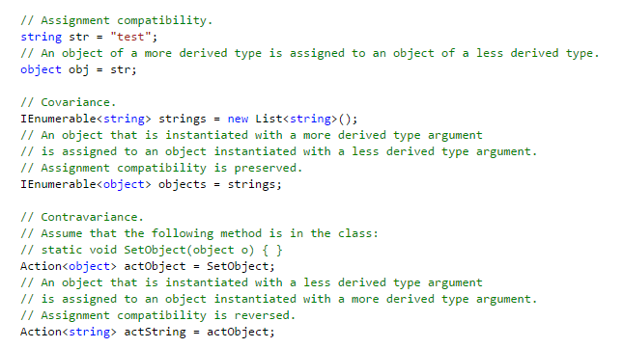
Using Generics – Variance and Covariant
  Covariance and contravariance enable implicit reference conversion for array types, delegate types, and generic type arguments. Covariance preserves assignment compatibility and contravariance reverses
  The following code demonstrates the difference between assignment compatibility, covariance, and contravariance. (obj: less derived type, str: more derived type)
ELCA VN 2007 v1.0

Slide 56
Using Generics – Variance in Generic Interfaces
  IEnumerable<T> (T is covariant)
  IEnumerator<T> (T is covariant)
  IQueryable<T> (T is covariant)
  IGrouping<TKey, TElement> (TKey and TElement are covariant)
  IComparer<T> (T is contravariant)
  IEqualityComparer<T> (T is contravariant)
  IComparable<T> (T is contravariant)
ELCA VN 2007 v1.0

Slide 57
LINQ
ELCA VN 2007 v1.0

Slide 58
Motivation
  Language-Integrated Query (LINQ) is a set of features introduced in Visual Studio 2008 that extends powerful query capabilities to the language syntax of C#
  LINQ introduces standard, easily-learned patterns for querying and updating data, and the technology can be extended to support potentially any kind of data store.
  Visual Studio includes LINQ provider assemblies that enable the use of LINQ with .NET Framework collections, SQL Server databases, ADO.NET Datasets, and XML documents.
  LINQ samples:
    https://code.msdn.microsoft.com/101-LINQ-Samples-3fb9811b
    https://msdn.microsoft.com/en-us/library/gg509017.aspx
ELCA VN 2007 v1.0

Slide 59
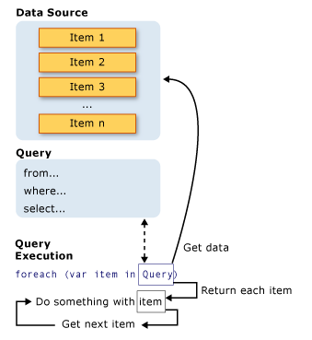
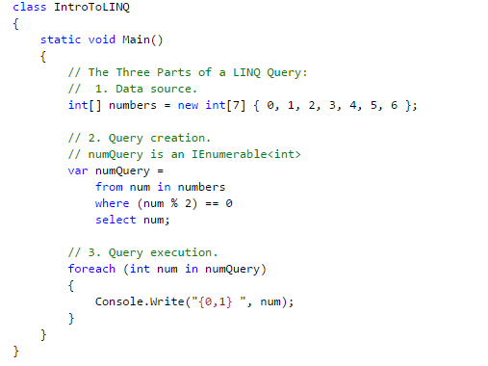
LINQ Queries
  All LINQ query operations consist of three distinct actions:
    Obtain the data source.
    Create the query.
    Execute the query.
ELCA VN 2007 v1.0

Slide 60
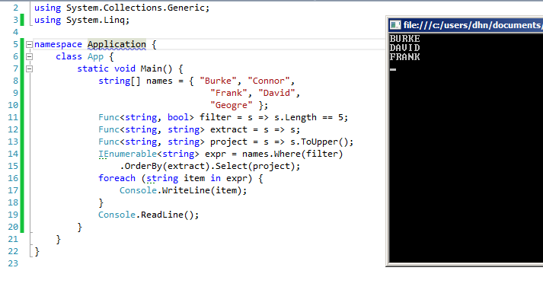
LINQ To Object
Native query syntax in C# : Intellisense, Auto completion
Query Operators can be used against any .NET collection (IEnumerable<T>: Select, where, groupby, join,..
Deferred query evaluation
Lambda expression
ELCA VN 2007 v1.0

Slide 61
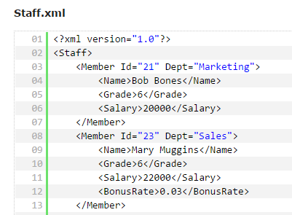
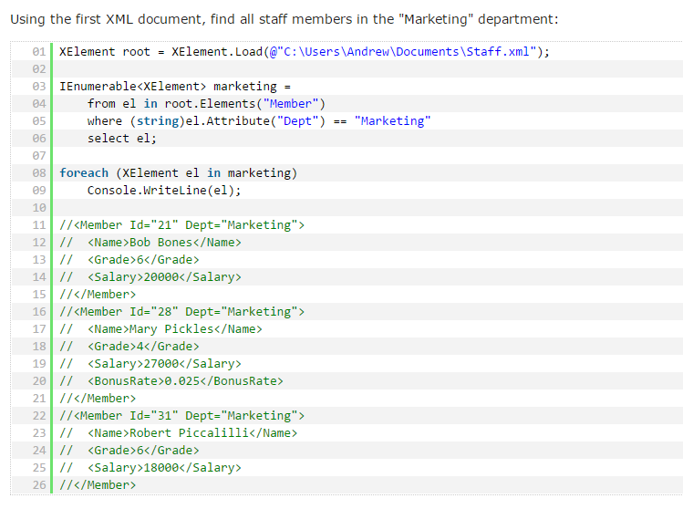
LINQ To XML
LINQ to XML is an up-to-date, redesigned approach to programming with XML. It provides the in-memory document modification capabilities of the Document Object Model (DOM), and supports LINQ query expressions. Although these query expressions are syntactically different from XPath, they provide similar functionality.
ELCA VN 2007 v1.0

Slide 62
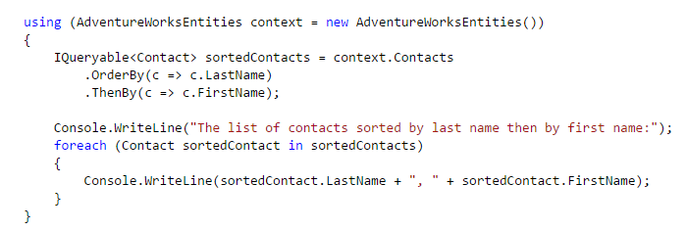
LINQ To Entities
LINQ to Entities provides Language-Integrated Query (LINQ) support that enables developers to write queries against the Entity Framework conceptual model using Visual Basic or Visual C#. The following is the process for creating and executing a LINQ to Entities query:
  Construct an ObjectQuery instance from ObjectContext.
  Compose a LINQ to Entities query in C# or Visual Basic by using the ObjectQuery instance.
  Convert LINQ standard query operators and expressions to command trees.
  Execute the query, in command tree representation, against the data source. Any exceptions thrown on the data source during execution are passed directly up to the client.
  Return query results back to the client.
ELCA VN 2007 v1.0

Slide 63
Other features
ELCA VN 2007 v1.0

Slide 64
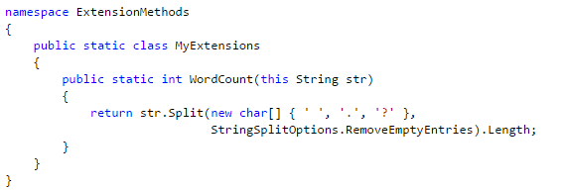


Extension methods
  Extension methods enable you to "add" methods to existing types without creating a new derived type, recompiling, or otherwise modifying the original type.
  Extension methods are a special kind of static method, but they are called as if they were instance methods on the extended type.
  This is keyword which is used to tell that it’s an extension method.
ELCA VN 2007 v1.0

Slide 65
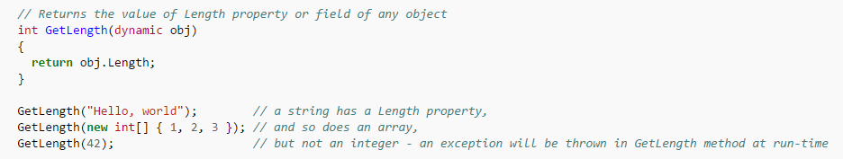
Dynamic object
  A new pseudo­type dynamic is introduced into the C# type system. It is treated as System.Object, but inaddition, any member access (method call, field, property, or indexer access, or a delegate invocation) or application of an operator on a value of such type is permitted without any type checking, and its resolution is postponed until run­time. This is known as duck typing
ELCA VN 2007 v1.0

Slide 66
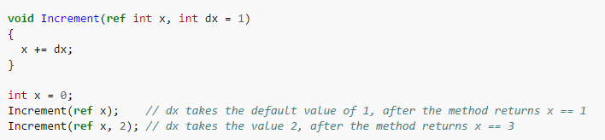
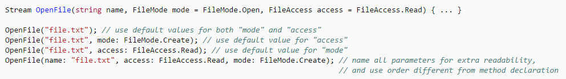
Optional parameters and named arguments
C# 4.0 introduces optional parameters with default values as seen in Visual Basic and C++.
ELCA VN 2007 v1.0

Slide 67
initializers
  Object initializers
    Customer c = new Customer();
    c.Name = "John";
    can be written
    Customer c = new Customer { Name = "John" };
  Collection initializers
    MyList list = new MyList();
    list.Add(1);
    list.Add(2);
    can be written as
    MyList list = new MyList { 1, 2 };
ELCA VN 2007 v1.0

Slide 68
Anonymous types
  Anonymous types provide a convenient way to encapsulate a set of read-only properties into a single object without having to first explicitly define a type. The type name is generated by the compiler and is not available at the source code level. The type of the properties is inferred by the compiler.
  For ex:
  var x = new { FirstName = "John", LastName = "Doe" };
  Anonymous types are reference types that derive directly from object. The compiler gives them a name although your application cannot access it. From the perspective of the common language runtime, an anonymous type is no different from any other reference type, except that it cannot be cast to any type except for object.
  If two or more anonymous types have the same number and type of properties in the same order, the compiler treats them as the same type and they share the same compiler-generated type information
ELCA VN 2007 v1.0

Slide 69
Thank you for your attention
For further information
please contact: hung.vong@orientsoftware.com

